Slide 1


AGE 316:
MICROCOMPUTER SYSTEMS
LECTURE 14: WIRELESS & NETWORKING
Dr. Kadeghe Fue
Department of Agricultural Engineering

Slide 2







Recap: Wired Protocols
UART (Serial)
I2C
SPI
1-to-1 Communication. Good for debugging and GPS.
Many devices, 2 wires. Good for sensors close to the board.
High speed. Good for SD Cards and Displays.
Today: We cut the cord and go Wireless.

Slide 3

Why go Wireless?
Advantages
Challenges
Mobility: Robots, Drones, Wearables.
Power: Radios eat batteries quickly.
Range: Monitor fields without running kilometers of cable.
Security: Signals can be intercepted.
Complexity: Harder to code and debug.
Connectivity: Send data to the Internet (Cloud).

Slide 4

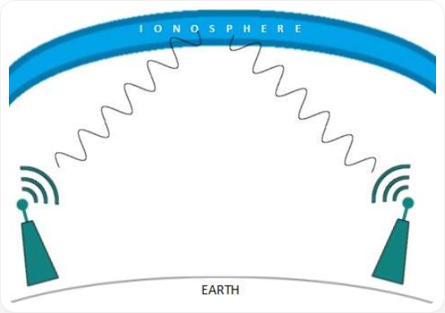
The Invisible Highway: Radio Waves
2.4 GHz Band
The "Wild West" of wireless. Most DIY electronics live here.
•
Bluetooth: Short range, low power.
•
Wi-Fi: High speed, internet access.
•
Zigbee: Mesh networks (Smart Home).
Note: Since everyone uses 2.4 GHz, interference (noise) is common.

Slide 5




Protocol 1: Bluetooth
Best for: Personal Area Network (PAN). Connecting a device to a Phone or Laptop nearby.
Classic (2.0)
BLE (4.0+)
Easy to use (Serial Port Profile). Continuous data stream. Higher power.
Low Energy. Bursts of data. Batteries last years. Harder to code.

Slide 6

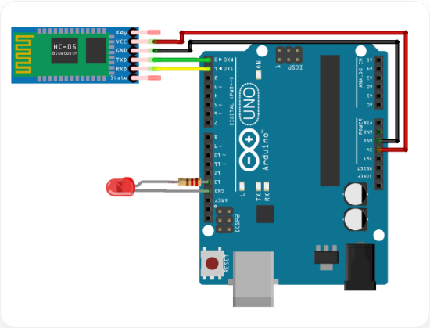
Hardware: The HC-05 Module
The Bridge
The HC-05 is a Serial-to-Bluetooth Bridge.
•
To Arduino: It talks UART (TX/RX).
•
To Phone: It talks Bluetooth.
Result: It looks like a wireless cable. Whatever you Serial.print() arrives on the phone!

Slide 7

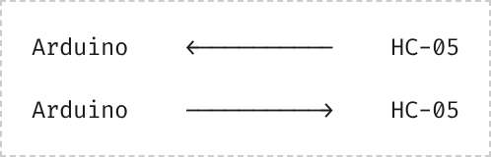

Wiring HC-05
Pinout
•
VCC: 5V
•
GND: Ground
RX
TX
•
TX: Transmit (Connects to Arduino RX)
TX
RX
•
RX: Receive (Connects to Arduino TX)

Slide 8
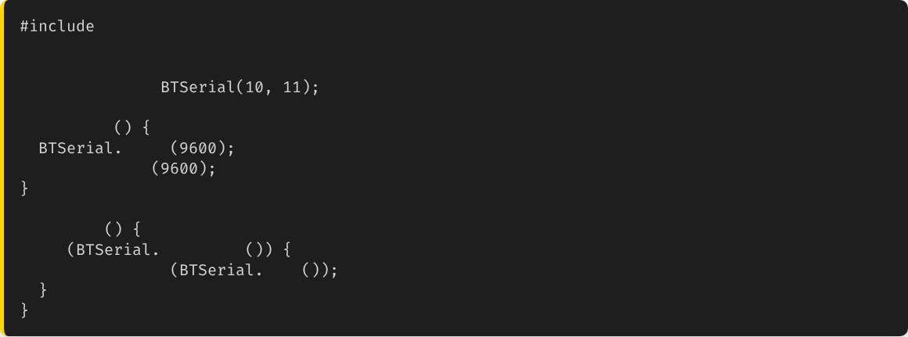
Code: Software Serial
We use a library to create a "Virtual" Serial port on pins 10 and 11, so we keep the USB port free for debugging.
// RX, TX
SoftwareSerial
void
setup
begin
// Start Bluetooth
Serial.begin
// Start PC Comms
void
loop
if
available
Serial.write
read

Slide 9

Protocol 2: Wi-Fi
Connecting to the World
Bluetooth connects to a phone. Wi-Fi connects to the Internet.
•
Connect to a Router (Access Point).
•
Get an IP Address.
WLAN
•
Send data to a Cloud Server/Database.

Slide 10
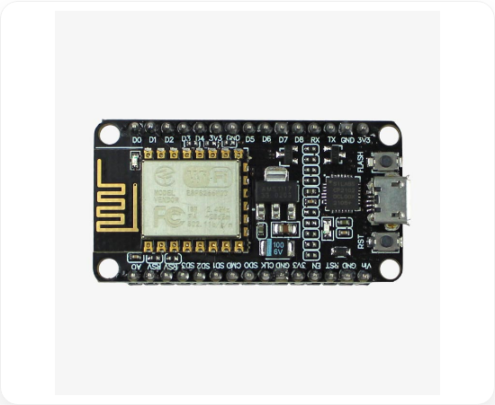
The Game Changer: ESP8266
More than a Module
Initially, this was just a Wi-Fi shield for Arduino.
Discovery: The ESP8266 is actually a much faster microcontroller than the Arduino Uno!
We can program it directly using the Arduino IDE. We don't even need the Uno board.

Slide 11





Comparison: Uno vs ESP8266
Arduino Uno
NodeMCU (ESP8266)
Speed: 16 MHz
Speed: 80 MHz
Flash: 32 KB
Flash: 4 MB (Huge!)
Wi-Fi: No
Wi-Fi: Built-in
Voltage: 5V
Voltage: 3.3V
Warning: ESP8266 is 3.3V logic! 5V will fry it.

Slide 12
Networking Basics
To use Wi-Fi, you need to know the lingo.
SSID: The name of your Wi-Fi network (e.g., "SUA-Student-WiFi").
IP Address: The device's address on the network (e.g., 192.168.1.105).
Client: A device that asks for info (Your browser, the ESP8266 uploading data).
Server: A device that holds info (Google.com, or the ESP8266 hosting a page).

Slide 13



IoT: Internet of Things
IoT
"The network of physical objects—'things'—embedded with sensors, software, and connectivity to exchange data over the internet."

Slide 14





IoT Architecture
Gateway
Edge Device
Cloud
The Wi-Fi Router. Connects the Edge to the Internet.
The Microcontroller (ESP8266) + Sensors. Collects raw data.
Server/Database (ThingSpeak, Firebase). Stores and visualizes data.

Slide 15

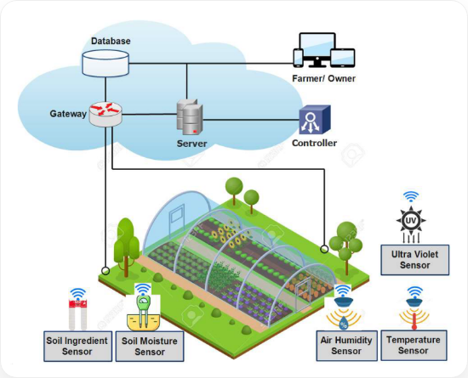
Application: Smart Farming
Scenario:
A farmer has a greenhouse 1km away.
1.
Sense: ESP8266 reads Soil Moisture sensor.
2.
Send: ESP8266 uses Wi-Fi to send data to the Cloud.
3.
Visualize: Farmer checks phone app. Sees "Soil Dry".
4.
Act: Farmer presses "Water" on app. ESP8266 turns on relay.

Slide 16



Summary
Bluetooth
Wi-Fi
IoT
Short range. Great for direct phone-to-device control (HC-05).
Internet access. Essential for IoT. Use ESP8266 or ESP32.
Connecting physical sensors to the Cloud for remote monitoring.

Slide 17

Questions?
"The only stupid question is the one you don't ask."
Dr. Kadeghe Fue
Sokoine University of Agriculture

Slide 18





Image Sources
https://www.tutorialspoint.com/data_communication_computer_network/images/radio_wave_ionosphere.jpg
Source: www.tutorialspoint.com
https://projects.arduinocontent.cc/cover-images/b0adeb5a-c7fa-49e5-a836-67f822e1a647.blob
Source: arduino.cc
http://quartzcomponents.com/cdn/shop/files/ESP8266-NodeMCU_018abef1-dfa7-4405-9d8e-209a0458ad67_1200x1200.jpg?v=1685702043
Source: quartzcomponents.com
https://pub.mdpi-res.com/applsci/applsci-12-03396/article_deploy/html/images/applsci-12-03396-g007.png?1648367605
Source: www.mdpi.com

